Slide 1
Post-Market surveillance of Illumina products
Ivan Charkin, Jeff Leath, Alec Neff

Slide 2
Summary
The goal of this project is to collect the post-market data on the performance of products made by Illumina and organize the information into a database
The data is obtained from Twitter by scraping with a custom R script
The data is then organized using a schema crated using MySQL

Slide 3
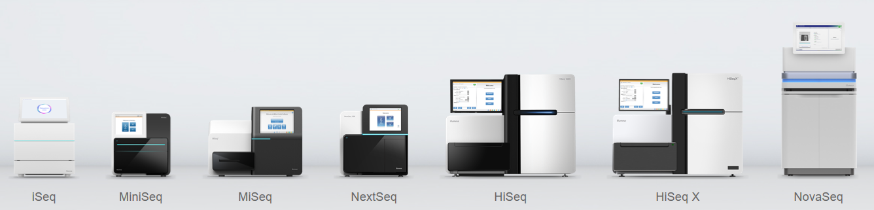
Illumina
Illumina is a leading company in the DNA sequencing market
It produces multiple platforms of DNA sequencers for various applications and consumables used for sequencing runs
The products are used for both research and medical diagnostics purposes
www.illumina.com

Slide 4

Post-market surveillance
It is a good practice to proactively seek customer feedback instead of relying on complaints only
For medical devices proactive collection of data is required per Federal Regulations as part of post-market surveillance to identify any problems as soon as possible
The data are supposed to be collected during the whole time the product is on the market

Slide 5
Sources of data
Customer complaints
Customer polls and questionnaires
Parts return data
Returns data
Etc.
In this project we will create a database based on customer comments in social media to enable data analysis

Slide 6
Data scraping
To scrape data from Twitter we will use R script
The following keywords are used:
Illumina
MiSeq
MiniSeq
NextSeq
NovaSeq
iSeq
HiSeq
…

Slide 7
Scraping cont.
library("twitteR") – used to scrape data from Twitter
Results are imported into a CSV file
library(tm) – used to perform text analysis
Remove punctuation
Convert to lower case
???? We probably do not need to remove the numbers since those may be relevant to the discussion

Slide 8
Database schema
The following attributes will be recorded:
Product
Date
Author of the post
Text

Slide 9
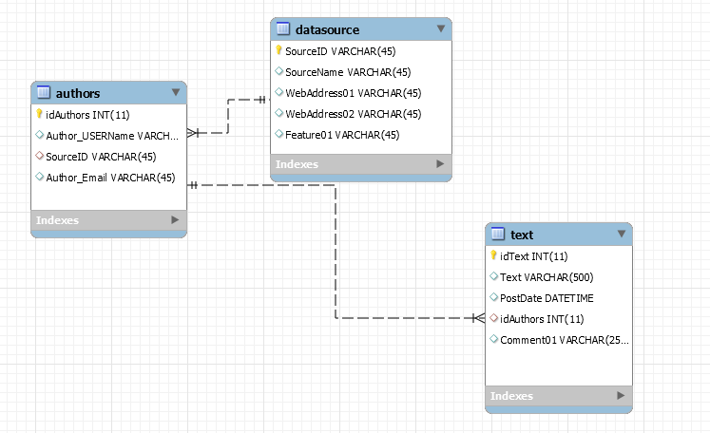
Schema image

Slide 10
Natural language processing
To convert the data from scraped customer comments to the attributes the following was used…

Slide 11
More details on NLP

Slide 12
Preliminary data

Slide 13
Complications
Not all tweets are in English – need to sort or translate
…

Slide 14
Next steps
…

Slide 21
Last Slide
Fade to black after 15 seconds

